Slide 1
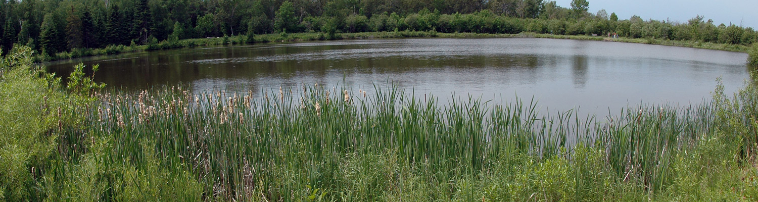








Minnesota’s
Clean Water Roadmap
Setting long-range goals for Minnesota’s water resources

Slide 2
In this presentation…
Roadmap purpose
  Why are we doing this? Who is it for? What will it contain? How will it be used?
Roadmap goals
  Lake water quality
  River and stream water quality
  Groundwater quality
  Groundwater quantity
  Progress towards goals

Slide 3
Roadmap Purpose
Communicate conditions, trends, and goals
Assess progress
Help guide implementation
Help inform resource allocations

Slide 4
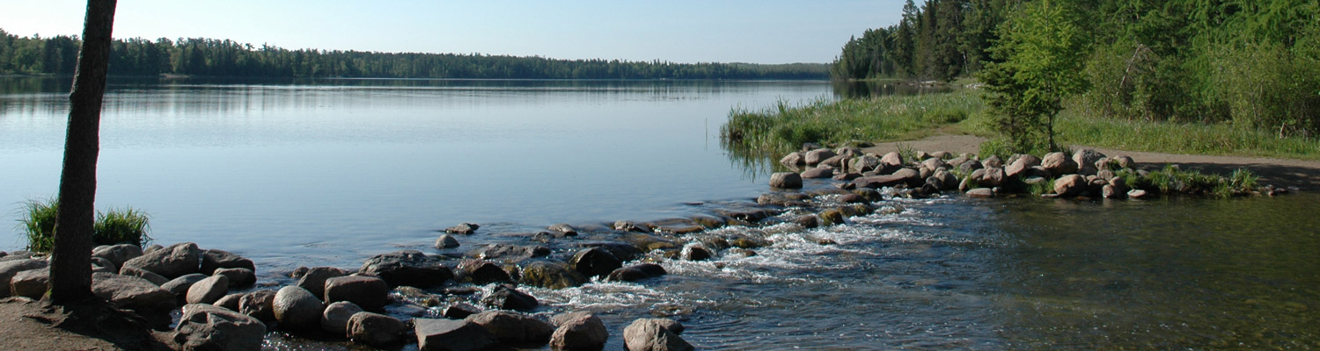
Audiences
Who is the Roadmap for?
  State agencies
  Interested and informed stakeholders
  Other members of the public

Slide 5
STATEWIDE
Roadmap
State Funding Priorities
Watershed and Groundwater Restoration and Protection Strategies
Local Water Plans
GOALS
WATERSHED
ACTIONS
Clean Water Fund
Performance Report

Slide 6
How will the Roadmap be used?
5 Year Revisions
5 Year Revisions
5 Year Revisions
2014
2019
2024
2029
2034
ICT
review
ICT
review
ICT
review
ICT
review
ICT
review
ICT
review
ICT
review
ICT
review
Input from Clean Water Council as well as other interested stakeholders
will be taken during the five year review periods.

Slide 7
Goal-setting process
Goals should be ambitious, yet achievable
Important values: Human health, ecological value, cost effectiveness
Considered external factors and all available data

Slide 8
Roadmap Goals
Goals were set by State Agency Leadership and the Interagency Coordination Team for:
  Lake Water Quality
  River and Stream Water Quality
  Groundwater Quality
  Groundwater Quantity

Slide 9
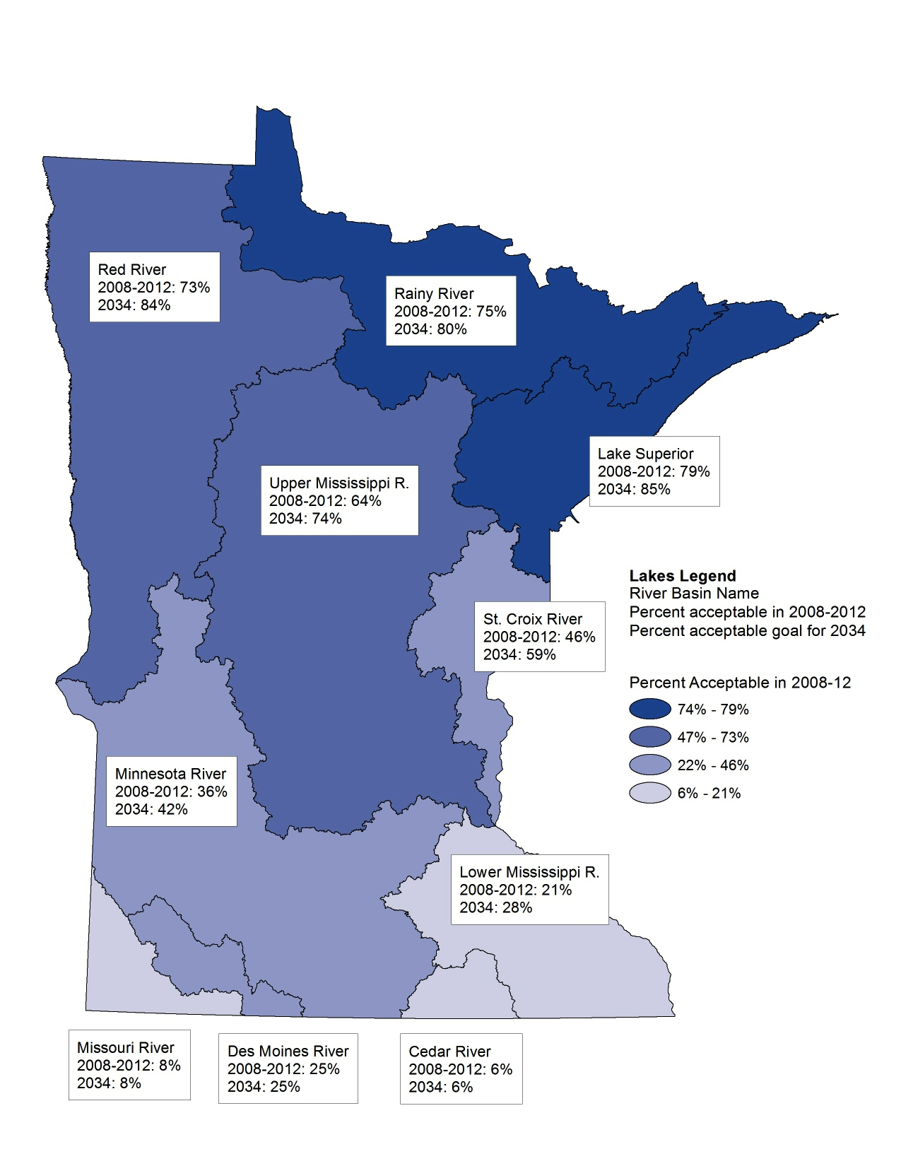
Lake Water Quality
Measure: Trophic State Index
2034 Goal: Increase the percentage of Minnesota lakes with good water quality from 62% to 70%.

Slide 10
Basin | Lakes in Baseline Population | Lakes Baseline 2008-2012 (percent acceptable) | Total Number Lakes Baseline Acceptable | Lakes Goals 2034 (percent acceptable) | Outcomes Percent Change
Lake Superior | 224 | 79% | 178 | 85% | Improve 6%
Upper Mississippi | 1,679 | 64% | 1,081 | 74% | Improve 10%
Minnesota | 472 | 36% | 172 | 42% | Improve 6%
St. Croix | 186 | 46% | 85 | 59% | Improve 13%
Lower Mississippi | 80 | 21% | 17 | 28% | Improve 7%
Cedar | 16 | 6% | 1 | 6% | Progress
Des Moines | 61 | 25% | 15 | 25% | Progress
Red | 443 | 73% | 322 | 84% | Improve 11%
Rainy | 643 | 75% | 483 | 80% | Improve 5%
Missouri | 13 | 8% | 1 | 8% | Progress
Total | 3,817 |  | 2,355

Slide 11
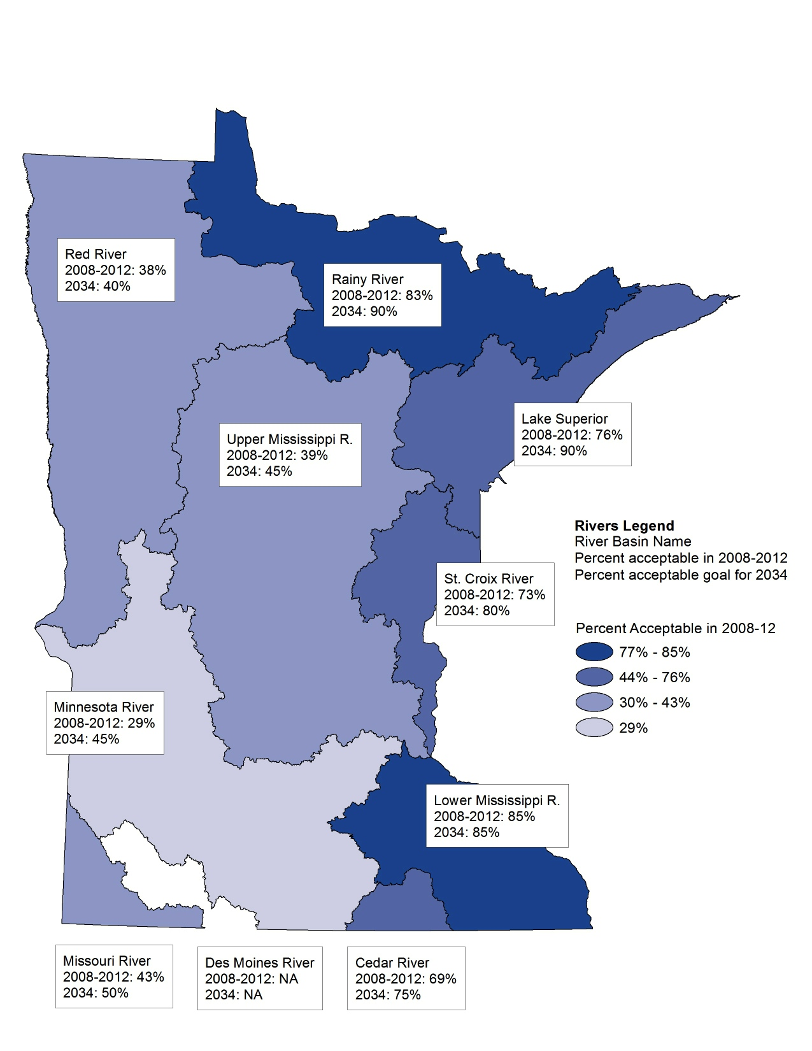
River and Stream Water Quality
Measure: Fish-Based Index of Biotic Integrity
2034 Goal: Increase the percentage of Minnesota rivers and streams with healthy fish communities from 60% to 67%.

Slide 12
Basin | River/Stream Sites in Baseline Population | River/Stream Sites Baseline 2008-2012 (percent acceptable) | Total Number River/Stream Sites Baseline Acceptable | River/Stream Sites Goals 2034 (percent acceptable) | Outcomes Percent Change
Lake Superior | 200 | 76% | 152 | 90% | Improve 14%
Upper Mississippi | 475 | 39% | 183 | 45% | Improve 6%
Minnesota | 339 | 29% | 98 | 45% | Improve 16%
St. Croix | 97 | 73% | 71 | 80% | Improve 7%
Lower Mississippi | 365 | 85% | 310 | 85% | Progress
Cedar | 92 | 69% | 63 | 75% | Improve 6%
Des Moines | 0 | N/A | N/A | N/A | N/A
Red | 219 | 38% | 83 | 40% | Improve 2%
Rainy | 134 | 83% | 111 | 90% | Improve 7%
Missouri | 117 | 43% | 50 | 50% | Improve 7%
Total | 2,038 |  | 1,121

Slide 13
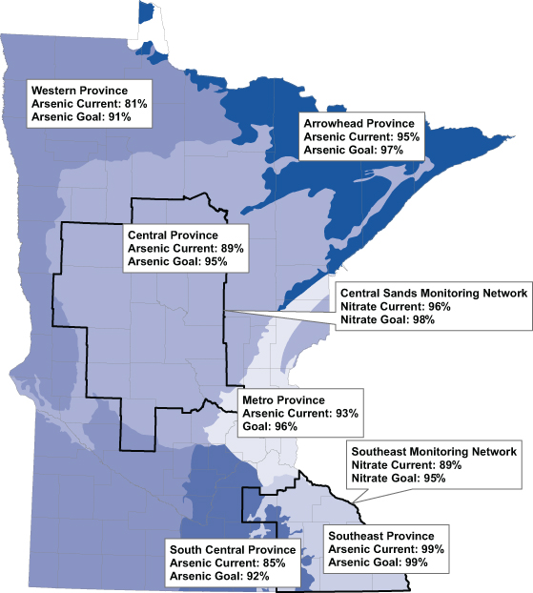
Groundwater Quality
Measure: Drinking water standards for arsenic and nitrate
2034 Goal: Reduce nitrate levels in groundwater by 20%.
Reduce the percentage of new wells exceeding the arsenic standard by 50%
Notes:
20% reduction in nitrate levels in groundwater = reduction in the percentage of wells exceeding the drinking water standard by 50% (in two vulnerable areas of the state)

Slide 14
Groundwater Quality
Province | Arsenic Current | Arsenic Goal | Nitrate Current | Nitrate Goal
Arrowhead | 95% | 97% | - | -
Western | 81% | 91% | - | -
Central | 89% | 95% | - | -
Metro | 93% | 96% | - | -
South Central | 85% | 92% | - | -
Southeast | 99% | 99% | - | -
Central Sands Network | - | - | 96% | 98%
Southeast Network | - | - | 89% | 95%

Slide 15
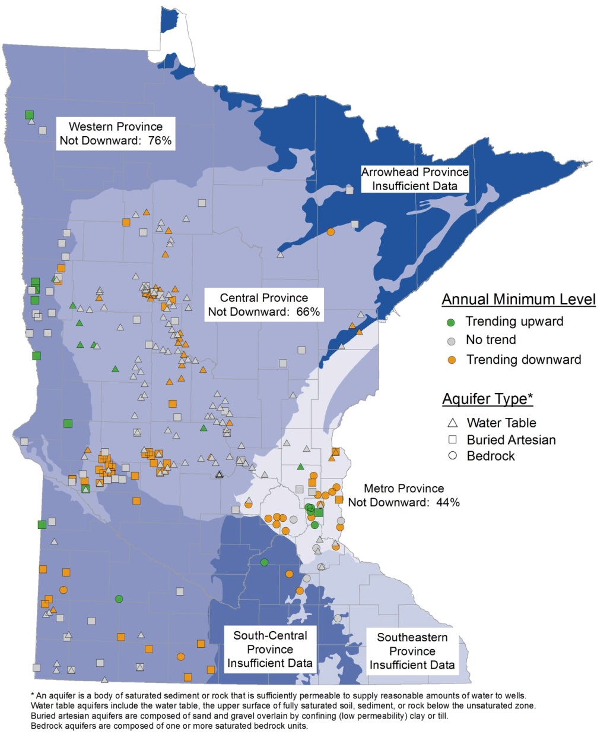
Groundwater Quantity
Measure: Changes over time in groundwater levels
2034 Goal: Ninety percent of groundwater monitoring sites affected by groundwater pumping will have either a steady or increasing trend

Slide 16
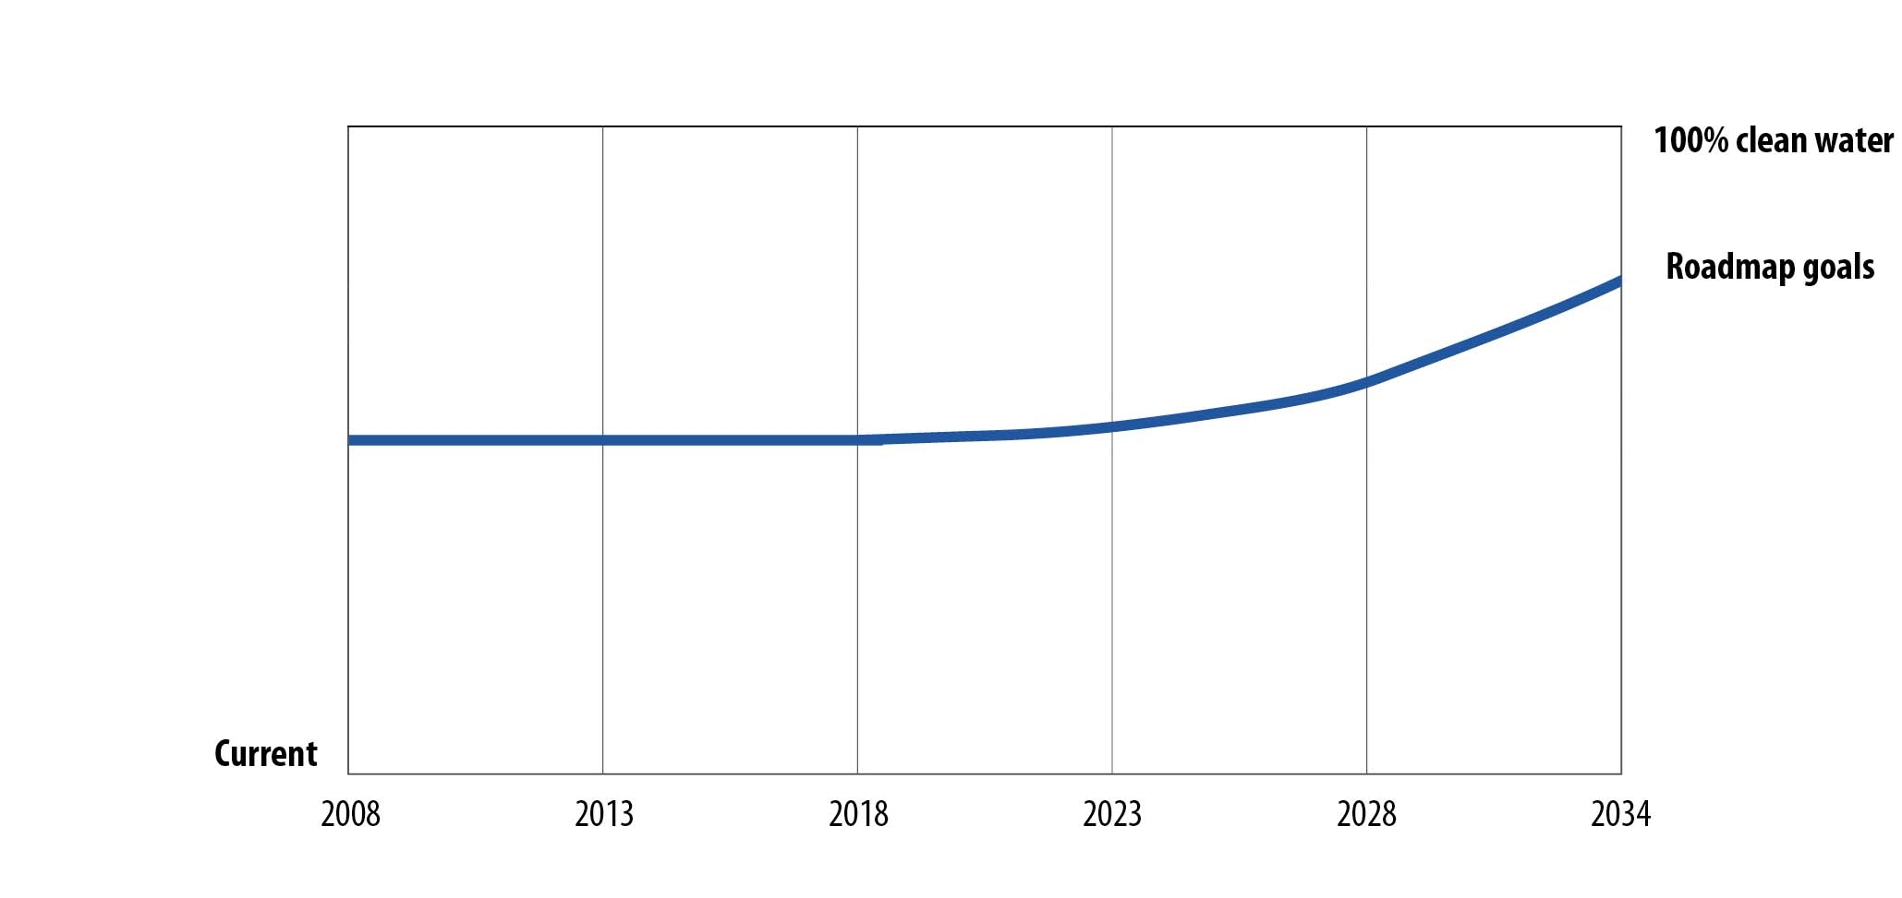
Progress towards Roadmap goals

Slide 17
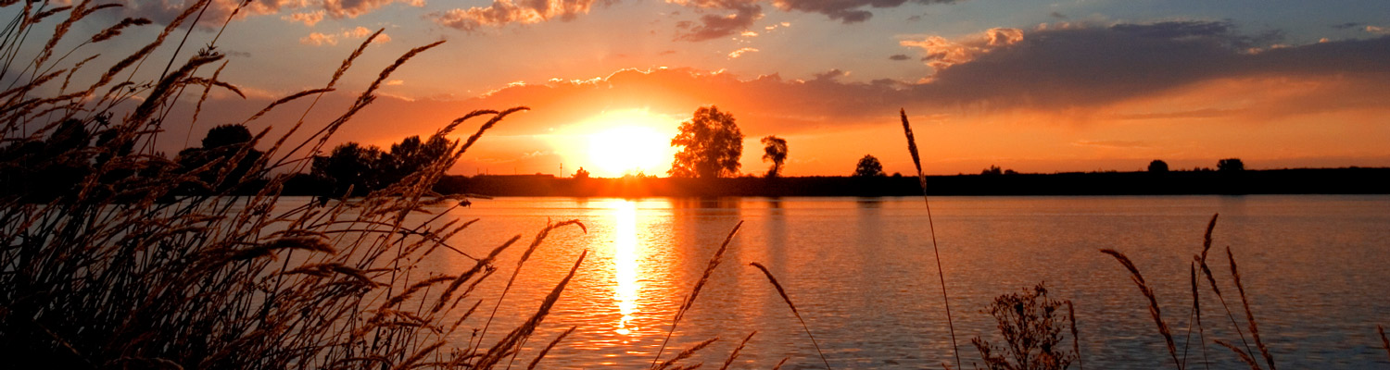
Five-Year Review
Whether we are on-track or off-track to meet goals
Whether or not any adjustments are needed to the indicators
Whether or not adjustments are needed to management strategies, funding priorities, or the goals themselves
Involvement of Clean Water Council and stakeholders

Slide 18
Minnesota’s
Clean Water Roadmap
Setting long-range goals for Minnesota’s water resources

